Slide 1


Python Programming Ⅰ
week 4

Slide 2
Python: Control Flow for Statement

Slide 3
Topic Structure
Task | Single Value | Multiple Values | numpy, pandas
Presentation (value, variable) | int, float, string, boolean | list, tuple, dictionary, set | ndarray, Series, DataFrame
Operation (algebra) | expressions | operations, mutable operations | expressions, get, set, reshape, …
Control flow | if for while
Use and reuse | Functions Standard libraries Modules and Packages
Input and output | Standard I/O File I/O |  | Standard I/O File I/O CSV, Excel

Slide 4
Learning Objectives
for Statement
for
Control Flow in for Statement
Repetition Controls for for Statement
break Statement
for-else
for-if
for-for (nested for)
continue/break/pass Statement

Slide 5
The for Statement
The for…in statement is another looping statement which iterates over a sequence of objects i.e. go through each item in a sequence.
A sequence is just an ordered collection of items.
A for statement can have an optional else clause.
When included, it is always executed once after the for loop is over unless a break statement is encountered.

Slide 6
Syntax of for Statement
for item in sequence:
statements1
else: # optional
statements2 # optional

Slide 7
Variation: for
for item in sequence:
statements1
else: # optional
statements2 # optional

Slide 8
Variation: for-else
for item in sequence:
statements1
else: # optional
statements2 # optional

Slide 9
Learning Objectives
for Statement
for
Control Flow in for Statement
Repetition Controls for for Statement
break Statement
for-else
for-if
for-for (nested for)
continue Statement

Slide 10
Flow Diagram: for
for item in sequence:
statements
Item from sequence
Next item from sequence
If no more item in sequence
statements

Slide 11
Control Flow in for
for item in sequence:
statements

Slide 12
Control Flow in for
for item in sequence: # 1st item in sequence
statements

Slide 13
Control Flow in for
for item in sequence: # 1st item in sequence
statements # item = 1st item

Slide 14
Control Flow in for
for item in sequence: # 2nd item in sequence
statements

Slide 15
Control Flow in for
for item in sequence: # 2nd item in sequence
statements # item = 2nd item

Slide 16
Control Flow in for
for item in sequence: # ... item in sequence
statements

Slide 17
Control Flow in for
for item in sequence: # ... item in sequence
statements # item = ... item

Slide 18
Control Flow in for
for item in sequence: # last item in sequence
statements

Slide 19
Control Flow in for
for item in sequence: # last item in sequence
statements # item = last item

Slide 20
Control Flow in for
for item in sequence:
statements
# Terminate

Slide 21
Example: Control Flow in for
Print out the integers 1, 2, and 4.
for i in range(10):
print(i)

Slide 22
Example: Control Flow in for
Print out the integers 1, 2, and 4.
for i in [1, 2, 4]:
print(i)

Slide 23
Example: Control Flow in for
Print out the integers 1, 2, and 4.
for i in [1, 2, 4]: # 1
print(i)

Slide 24
Example: Control Flow in for
Print out the integers 1, 2, and 4.
for i in [1, 2, 4]: # 1
print(i) # i = 1

Slide 25
Example: Control Flow in for
Print out the integers 1, 2, and 4.
for i in [1, 2, 4]: # 2
print(i)

Slide 26
Example: Control Flow in for
Print out the integers 1, 2, and 4.
for i in [1, 2, 4]: # 2
print(i) # i = 2

Slide 27
Example: Control Flow in for
Print out the integers 1, 2, and 4.
for i in [1, 2, 4]: # 4
print(i)

Slide 28
Example: Control Flow in for
Print out the integers 1, 2, and 4.
for i in [1, 2, 4]: # 4
print(i) # i = 4

Slide 29
Example: Control Flow in for
Print out the integers 1, 2, and 4.
for i in [1, 2, 4]:
print(i)
# Terminate

Slide 30
Flow Diagram: for
for item in sequence:
statements
Item from sequence
Next item from sequence
If no more item in sequence
statements

Slide 31
Sequence: List (discussed later)
for i in [1, 2, 4]:
print(i)

Slide 32
Sequence: Tuple (discussed later)
for i in (1, 2, 4):
print(i)

Slide 33
Sequence: Set (discussed later)
for i in set(['brazil', 'russia', 'india', 'india']):
print(i)

Slide 34
Sequence: Dictionary (discussed later)
for i in {
'Swaroop' : 'swaroop@swaroopch.com',
'Larry' : 'larry@wall.org',
'Matsumoto' : 'matz@ruby-lang.org',
'Spammer' : 'spammer@hotmail.com'
}:
print(i)

Slide 35
Sequence: Dictionary (discussed later)
for i, j in {
'Swaroop' : 'swaroop@swaroopch.com',
'Larry' : 'larry@wall.org',
'Matsumoto' : 'matz@ruby-lang.org',
'Spammer' : 'spammer@hotmail.com'
}.items():
print(i, j)

Slide 36
Sequence: String (discussed later)
for i in "abc":
print(i)
for i in ['a', 'b', 'c']:
print(i)

Slide 37

Sequence: String
for i in "abc":
print(i)
for i in ['a', 'b', 'c']:
print(i)
https://static1.srcdn.com/wordpress/wp-content/uploads/2022/09/The-matrix-Red-pill-Blue-pill-neo.jpg

Slide 38
Learning Objectives
for Statement
for
Control Flow in for Statement
Repetition Controls for for Statement
break Statement
for-else
for-if
for-for (nested for)
continue Statement

Slide 39
Cases of Repetition Controls for for Statement
The cases in which number of iterations is fixed.
The cases in which number of iterations is not fixed.
A flag variable
break statement

Slide 40
flag variable
text = "abcdefg"
# The element we are searching for
target = "k"
# Initialize the flag variable
found = False
# Iterate through the text
for character in text:
if character == target:
# Set the flag to True if the target is found
found = True
break # Exit the loop as we found the target
# Use the flag variable to take further action
if found:
print(f"character '{target}' found in the text.")
else:
print(f"character '{target}' not found in the text.")

Slide 41
Example: Fixed Number of Iterations
Print out the integers from 1 to 10.
for i in [1, 2, 3, 4, 5, 6, 7, 8, 9, 10]:
print(i)

Slide 42
Example: Fixed Number of Iterations
Print out the integers from 0 to 9.
for i in [0, 1, 2, 3, 4, 5, 6, 7, 8, 9]:
print(i)

Slide 43
Example: Fixed Number of Iterations
Print out the integers from 1 to 10.
for i in [1, 2, 3, 4, 5, 6, 7, 8, 9, 10]:
print(i)
Print out the integers from 0 to 9.
for i in [0, 1, 2, 3, 4, 5, 6, 7, 8, 9]:
print(i)

Slide 44
Built-in Function: range
Built-in range function generates an immutable sequence of numbers, which is generally used to iterate over with for loops.
Syntax
range(stop)
range(start, stop[, step])
range(start, stop)
range(start, stop, step)

Slide 45
Example: range(stop)
nums = list(range(10))
print(nums)
# [0, 1, 2, 3, 4, 5, 6, 7, 8, 9]
nums = list(range(0))
print(nums)
# []

Slide 46
Example: range(start, stop)
nums = list(range(1, 11))
print(nums)
# [1, 2, 3, 4, 5, 6, 7, 8, 9, 10]
nums = list(range(1, 0))
print(nums)
# []

Slide 47
Example: range(start, stop, step)
nums = list(range(0, 30, 5))
print(nums)
# [0, 5, 10, 15, 20, 25]
nums = list(range(0, 10, 3))
print(nums)
# [0, 3, 6, 9]
nums = list(range(0, -10, -1))
print(nums)
# [0, -1, -2, -3, -4, -5, -6, -7, -8, -9]

Slide 48
Example: range
print(list(range(10)))
# [0, 1, 2, 3, 4, 5, 6, 7, 8, 9]
print(list(range(0)))
# []
print(list(range(1, 11)))
# [1, 2, 3, 4, 5, 6, 7, 8, 9, 10]
print(list(range(1, 0)))
# []
print(list(range(0, 30, 5)))
# [0, 5, 10, 15, 20, 25]
print(list(range(0, 10, 3)))
# [0, 3, 6, 9]
print(list(range(0, -10, -1)))
# [0, -1, -2, -3, -4, -5, -6, -7, -8, -9]

Slide 49
Example: Fixed Number of Iterations
Print out the integers from 0 to 99.
for i in list(range(100)):
print(i)

Slide 50
Example: Fixed Number of Iterations - Iterator, Generator
Print out the integers from 0 to 99.
for i in list(range(100)):
print(i)
Print out the integers from 0 to 99.
for i in range(100):
print(i)

Slide 51
Example: Fixed Number of Iterations
Print out the integers from 0 to 99.
for i in list(range(100)):
print(i)
Print out the integers from 0 to 99.
for i in range(100):
print(i)

Slide 52
Example: Fixed Number of Iterations
Print out the integers from 1 to 100.
for i in range(1, 101):
print(i)

Slide 53
Example: Fixed Number of Iterations
Print out the floats 0.0, 0.1, …, 1.0.
for i in range(0.0, 1.1, 0.1): # ERROR
print(i)
0.0
0.1
0.2
0.3
0.4
0.5
0.6
0.7
0.8
0.9
1.0

Slide 54
Example: Fixed Number of Iterations
Print out the floats 0.0, 0.1, …, 1.0.
for i in range(0,11):
print(i/10.0)
0.0
0.1
0.2
0.3
0.4
0.5
0.6
0.7
0.8
0.9
1.0

Slide 55
Learning Objectives
for Statement
for
Control Flow in for Statement
Repetition Controls for for Statement
break Statement
for-else
for-if
for-for (nested for)
continue Statement

Slide 56
break Statement
The break statement is used to break out of a loop statement
i.e. stop the execution of a looping statement, even if the loop condition has not become False or the sequence of items has not been completely iterated over.
An important note is that if you break out of a for or while loop, any corresponding loop else block is not executed.

Slide 57
Example: Unfixed Number of Iterations – break Statement
iNumber = 23
for i in range(1000000):
iGuess = int(input('Enter an integer: '))
if iGuess == iNumber:
print('Congratulations, you guessed it.')
break
elif iGuess < iNumber:
print('No, it is a little higher than that.')
else:
print('No, it is a little lower than that.')
What if No break?

Slide 58
Example: Unfixed Number of Iterations – break Statement
iNumber = 23
for i in range(1000000):
iGuess = int(input('Enter an integer: '))
if iGuess == iNumber:
print('Congratulations, you guessed it.')
break
elif iGuess < iNumber:
print('No, it is a little higher than that.')
else:
print('No, it is a little lower than that.')
iNumber = 23
while True:
iGuess = int(input('Enter an integer: '))
if iGuess == iNumber:
print('Congratulations, you guessed it.')
break
elif iGuess < iNumber:
print('No, it is a little higher than that.')
else:
print('No, it is a little lower than that.')

Slide 59
Example: Unfixed Number of Iterations – if (exp.), while (exp.)
Find out the smallest integer which divides 121 evenly.
for i in range(2, 122):
if 121 % i == 0:
print(i)
break
Find out the smallest integer which divides 121 evenly.
i = 2
while 121 % i > 0:
i += 1
print(i)

Slide 60
Example: Avoiding Duplication
Find out the smallest integer which divides 121 evenly.
for i in range(2, 122):
if 121 % i == 0:
print(i)
break
Find out the smallest integer which divides 121 evenly.
n = 121
for i in range(2, n + 1):
if n % i == 0:
print(i)
break

Slide 61
Example: Unfixed Number of Iterations – break Statement
for i in range(1000000):
s = input('Enter something: ')
if s == 'quit':
break
print('Length of the string is', len(s))
print('Done')
while True:
s = input('Enter something: ')
if s == 'quit':
break
print('Length of the string is', len(s))
print('Done')

Slide 62
Learning Objectives
for Statement
for
Control Flow in for Statement
Repetition Controls for for Statement
break Statement
for-else
for-if
for-for (nested for)
continue Statement

Slide 63
Flow Diagram: for-else
for item in sequence:
statements1
else:
statements2
Item from sequence
Next item from sequence
If no more item in sequence
statements
statements2

Slide 64
Control Flow in for-else
for item in sequence:
statements1
else:
statements2

Slide 65
Control Flow in for-else
for item in sequence: # 1st item in sequence
statements1
else:
statements2

Slide 66
Control Flow in for-else
for item in sequence: # 1st item in sequence
statements1 # item = 1st item
else:
statements2

Slide 67
Control Flow in for-else
for item in sequence: # 2nd item in sequence
statements1
else:
statements2

Slide 68
Control Flow in for-else
for item in sequence: # 2nd item in sequence
statements1 # item = 2nd item
else:
statements2

Slide 69
Control Flow in for-else
for item in sequence: # ... item in sequence
statements1
else:
statements2

Slide 70
Control Flow in for-else
for item in sequence: # ... item in sequence
statements1 # item = ... item
else:
statements2

Slide 71
Control Flow in for-else
for item in sequence: # last item in sequence
statements1
else:
statements2

Slide 72
Control Flow in for-else
for item in sequence: # last item in sequence
statements1 # item = last item
else:
statements2

Slide 73
Control Flow in for-else
for item in sequence:
statements1
else:
statements2

Slide 74
Control Flow in for-else
for item in sequence:
statements1
else:
statements2
# Terminate

Slide 75
Example: Control Flow in for-else
Print out the integers 1, 2, and 4.
for i in [1, 2, 4]:
print(i)
else:
print("Done")

Slide 76
Example: Control Flow in for-else
Print out the integers 1, 2, and 4.
for i in [1, 2, 4]: # 1
print(i)
else:
print("Done")

Slide 77
Example: Control Flow in for-else
Print out the integers 1, 2, and 4.
for i in [1, 2, 4]: # 1
print(i) # i = 1
else:
print("Done")

Slide 78
Example: Control Flow in for-else
Print out the integers 1, 2, and 4.
for i in [1, 2, 4]: # 2
print(i)
else:
print("Done")

Slide 79
Example: Control Flow in for-else
Print out the integers 1, 2, and 4.
for i in [1, 2, 4]: # 2
print(i) # i = 2
else:
print("Done")

Slide 80
Example: Control Flow in for-else
Print out the integers 1, 2, and 4.
for i in [1, 2, 4]: # 4
print(i)
else:
print("Done")

Slide 81
Example: Control Flow in for-else
Print out the integers 1, 2, and 4.
for i in [1, 2, 4]: # 4
print(i) # i = 4
else:
print("Done")

Slide 82
Example: Control Flow in for-else
Print out the integers 1, 2, and 4.
for i in [1, 2, 4]:
print(i)
else:
print("Done")

Slide 83
Example: Control Flow in for-else
Print out the integers 1, 2, and 4.
for i in [1, 2, 4]:
print(i)
else:
print("Done")
# Terminate

Slide 84
Flow Diagram: for-else
for item in sequence:
statements1
else:
statements2
Item from sequence
Next item from sequence
If no more item in sequence
statements
statements2

Slide 85
Example: for-else
for i in range(1, 5):
print(i)
else:
print('The for loop is over')
# range(1,5) gives the sequence [1, 2, 3, 4]
for-else
Item i from
range(1, 5)
If next item
If no more item
print(i)
print('over')

Slide 86
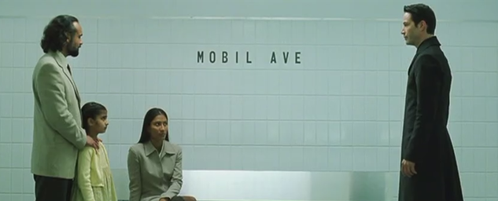
Example: for-else
Find out the smallest integer which divides 121 evenly and less than 121.
for i in range(2, 121):
if 121 % i == 0:
break
else:
print(i)
https://static.wikia.nocookie.net/matrix/images/b/be/Mobil_Ave.png/revision/latest?cb=20110213141234

Slide 87
Example: for-else
Find out the smallest integer which divides 121 evenly and less than 121.
for i in range(2, 121):
if 121 % i == 0:
break
print(i)

Slide 88
Example: for-else
Find out the smallest integer which divides 71 evenly and less than 71. (Note that 71 is prime.)
for i in range(2, 71):
if 71 % i == 0:
break
print(i)

Slide 89
Example: for-else
Find out the smallest integer which divides 71 evenly and less than 71. (Note that 71 is prime.)
for i in range(2, 71):
if 71 % i == 0:
print(i)
break

Slide 90
Example: for-else
Find out the smallest integer which divides 71 evenly and less than 71. (Note that 71 is prime.)
for i in range(2, 71):
if 71 % i == 0:
print(i)
break
Find out the smallest integer which divides 121 evenly and less than 121.
for i in range(2, 121):
if 121 % i == 0:
print(i)
break

Slide 91
Example: for-else
Find out the smallest integer which divides 71 evenly and less than 71. (Note that 71 is prime.)
for i in range(2, 71):
if 71 % i == 0:
print(i)
break
Find out the smallest integer which divides 121 evenly and less than 121.
for i in range(2, 121):
if 121 % i == 0:
print(i)
break

Slide 92
Example: for-else
Find out the smallest integer which divides 121 evenly and less than 121.
for i in range(2, 121):
if 121 % i == 0:
print(i)
break
Find out the smallest integer which divides 121 evenly and less than 121.
for i in range(2, 121):
if 121 % i == 0:
break
else:
print(i)

Slide 93
Example: for-else
Find out the smallest integer which divides 121 evenly and less than 121.
for i in range(2, 121):
if 121 % i == 0:
break
else:
print(i)
Find out the smallest integer which divides 121 evenly and less than 121.
for i in range(2, 121):
if 121 % i == 0:
break
else:
print(i)

Slide 94
Example: Avoiding Duplication
Find out the smallest integer which divides 121 evenly and less than 121.
for i in range(2, 121):
if 121 % i == 0:
print(i)
break
Find out the smallest integer which divides 121 evenly and less than 121.
n = 121
for i in range(2, n):
if n % i == 0:
print(i)
break

Slide 95
Example: for-else
iNumber = 23
for i in range(1000000):
iGuess = int(input('Enter an integer: '))
if iGuess == iNumber:
break
elif iGuess < iNumber:
print('No, it is a little higher than that.')
else:
print('No, it is a little lower than that.')
else:
print('Congratulations, you guessed it.')

Slide 96
Example: for-else
iNumber = 23
for i in range(1000000):
iGuess = int(input('Enter an integer: '))
if iGuess == iNumber:
print('Congratulations, you guessed it.')
break
elif iGuess < iNumber:
print('No, it is a little higher than that.')
else:
print('No, it is a little lower than that.')

Slide 97
Example: for-else
iNumber = 23
for i in range(1000000):
iGuess = int(input('Enter an integer: '))
if iGuess == iNumber:
print('Congratulations, you guessed it.')
break
elif iGuess < iNumber:
print('No, it is a little higher than that.')
else:
print('No, it is a little lower than that.')
iNumber = 23
for i in range(1000000):
iGuess = int(input('Enter an integer: '))
if iGuess == iNumber:
break
elif iGuess < iNumber:
print('No, it is a little higher than that.')
else:
print('No, it is a little lower than that.')
else:
print('Congratulations, you guessed it.')

Slide 98
Learning Objectives
for Statement
for
Control Flow in for Statement
Repetition Controls for for Statement
break Statement
for-else
for-if
for-for (nested for)
continue Statement

Slide 99
Example: for-if
Make a Python program which prints out every odd numbers between 1 and 100.
for
Item i from range(1, 100)
If no more item
If next item
n % 2 != 0
False
True
print(n)

Slide 100
Example: for-if
Make a Python program which prints out every odd numbers between 1 and 100.
for n in range(1, 101):
if n % 2 == 1:
print(n)

Slide 101
Example: for-if
Make a Python program which prints out every odd numbers between 1 and 100.
for n in range(1, 101, 2):
print(n)

Slide 102
Example: for-if
Make a Python program which prints out every even numbers between 1 and 100.
for
Item i from range(2, 100, 2)
If no more item
If next item
print(n)

Slide 103
Example: for-if
Make a Python program which prints out every even numbers between 1 and 100.
for n in range(1, 101):
if n % 2 == 0:
print(n)

Slide 104
Example: for-if
Make a Python program which prints out every even numbers between 1 and 100.
for n in range(2, 101, 2):
print(n)

Slide 105
Practice: for-if
Make a Python program which prints out numbers, 1, 4, 7, …, 100.
for
Item i from range(1, 100, 3)
If no more item
If next item
print(n)

Slide 106
Example: for-if
bPrime = True
for
Make a Python program which finds out whether 121 is prime or not.
Item i from
range(2, 121)
If next item
If no more item
121 % i == 0
False
True
bPrime = False
print(bPrime)

Slide 107
Example: for-if
Definition. A number n is prime if it is greater than one and if none of the numbers 2 , 3 , … , n − 1 divides n evenly.
n = 121
bPrime = True
for d in range(2, n):
if n % d == 0:
bPrime = False
print(d)
break
print(bPrime)

Slide 108
Example: for-if
Definition. A number n is prime if it is greater than one and if none of the numbers 2 , 3 , … , n − 1 divides n evenly.
n = 121
for d in range(2, n + 1):
if n % d == 0:
print(d)
break
print(d >= n)

Slide 109
Example: for-if
Definition. A number n is prime if it is greater than one and if none of the numbers 2 , 3 , … , n − 1 divides n evenly.
n = 71
for d in range(2, n):
if n % d == 0:
break
print(d >= n)

Slide 110
Example: for-if
Definition. A number n is prime if it is greater than one and if none of the numbers 2 , 3 , … , n − 1 divides n evenly.
n = 71
for d in range(2, n + 1):
if n % d == 0:
break
print(d >= n)
Definition. A number n is prime if it is greater than one and if none of the numbers 2 , 3 , … , n − 1 divides n evenly.
n = 71
for d in range(2, n):
if n % d == 0:
break
print(d >= n)

Slide 111
Example: for-if
Definition. A number n is prime if it is greater than one and if none of the numbers 2 , 3 , … , n − 1 divides n evenly.
n = 121
bPrime = True
for d in range(2, n):
if n % d == 0:
bPrime = False
break
print(bPrime)
Definition. A number n is prime if it is greater than one and if none of the numbers 2 , 3 , … , n − 1 divides n evenly.
n = 121
for d in range(2, n + 1):
if n % d == 0:
break
print(d >= n)

Slide 112
Example: for-if
Definition. A number n is prime if it is greater than one and if none of the numbers 2 , 3 , … , n − 1 divides n evenly.
n = 121
bPrime = True
for d in range(2, n):
if n % d == 0:
bPrime = False
break
print(bPrime)
Definition. A number n is prime if it is greater than one and if none of the numbers 2 , 3 , … , n − 1 divides n evenly.
n = 121
for d in range(2, n + 1):
if n % d == 0:
break
print(d >= n)

Slide 113
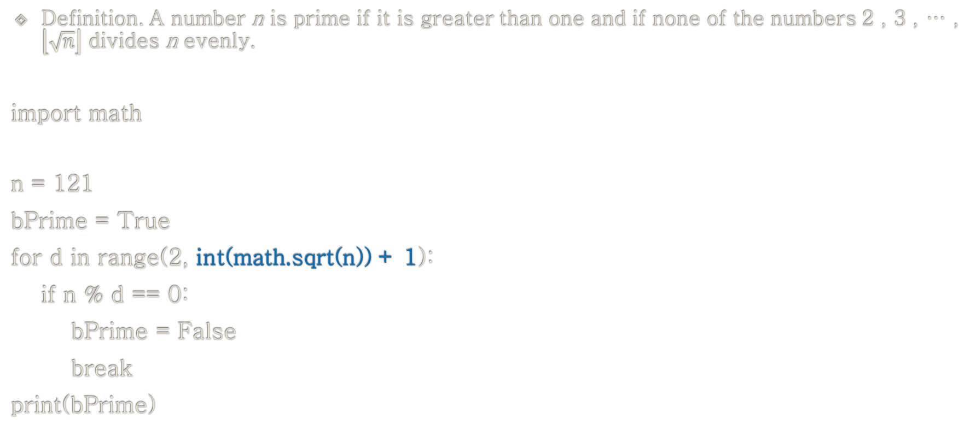
Example: for-if
Definition. A number n is prime if it is greater than one and if none of the numbers 2 , 3 , … , $\left\lfloor \sqrt{n}\right\rfloor$ divides n evenly.
import math
n = 121
bPrime = True
for d in range(2, int(math.sqrt(n)) + 1):
if n % d == 0:
bPrime = False
break
print(bPrime)

Slide 114
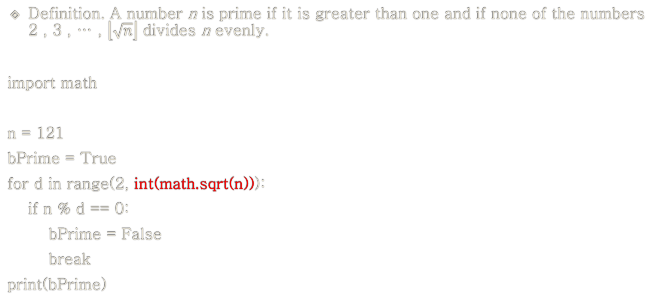
Example: for-if
Definition. A number n is prime if it is greater than one and if none of the numbers 2 , 3 , … , $\left\lfloor \sqrt{n}\right\rfloor$ divides n evenly.
import math
n = 121
bPrime = True
for d in range(2, int(math.sqrt(n))):
if n % d == 0:
bPrime = False
break
print(bPrime)

Slide 115
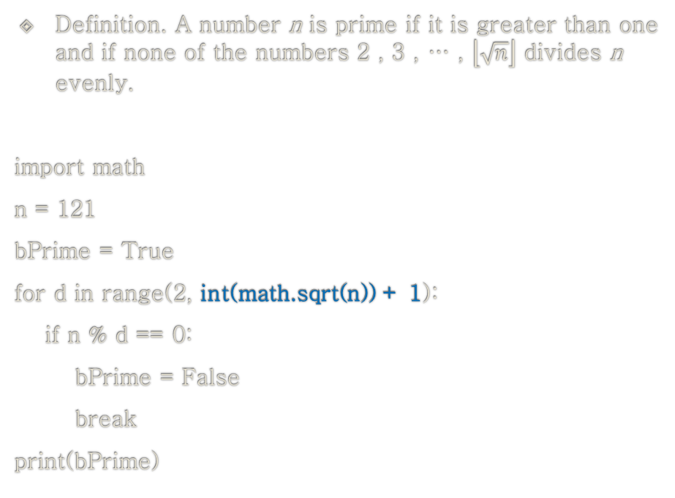
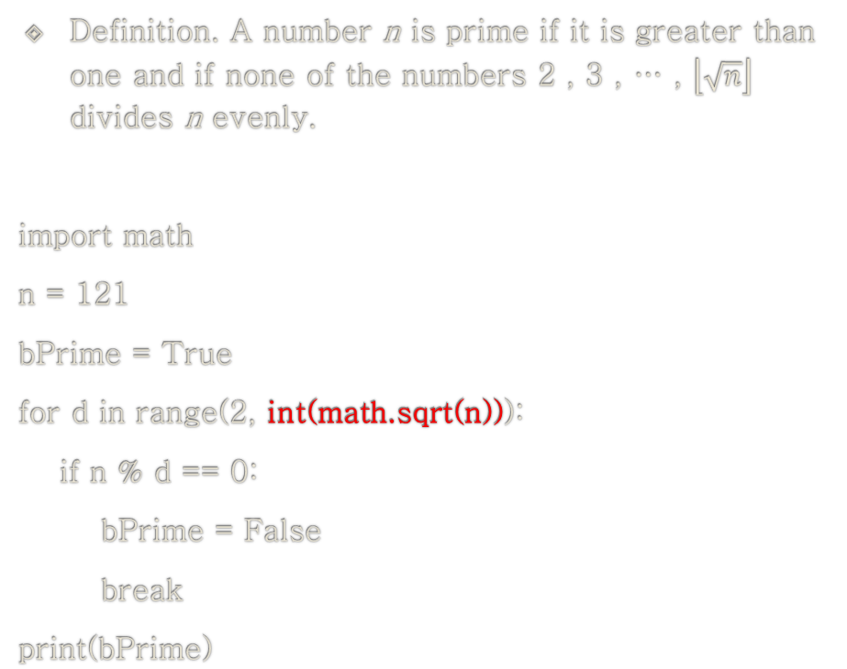
Example: for-if
Definition. A number n is prime if it is greater than one and if none of the numbers 2 , 3 , … , $\left\lfloor \sqrt{n}\right\rfloor$ divides n evenly.
import math
n = 121
bPrime = True
for d in range(2, int(math.sqrt(n))):
if n % d == 0:
bPrime = False
break
print(bPrime)
Definition. A number n is prime if it is greater than one and if none of the numbers 2 , 3 , … , $\left\lfloor \sqrt{n}\right\rfloor$ divides n evenly.
import math
n = 121
bPrime = True
for d in range(2, int(math.sqrt(n)) + 1):
if n % d == 0:
bPrime = False
break
print(bPrime)

Slide 116
Learning Objectives
for Statement
for
Control Flow in for Statement
Repetition Controls for for Statement
break Statement
for-else
for-if
for-for (nested for)
continue Statement

Slide 117

실습하기
print format

Slide 118
Example: for-for (nested for)
for i in range(1, 11):
for j in range(1, 11):
print(j, end=", ")
print()
1, 2, 3, 4, 5, 6, 7, 8, 9, 10,
1, 2, 3, 4, 5, 6, 7, 8, 9, 10,
1, 2, 3, 4, 5, 6, 7, 8, 9, 10,
1, 2, 3, 4, 5, 6, 7, 8, 9, 10,
1, 2, 3, 4, 5, 6, 7, 8, 9, 10,
1, 2, 3, 4, 5, 6, 7, 8, 9, 10,
1, 2, 3, 4, 5, 6, 7, 8, 9, 10,
1, 2, 3, 4, 5, 6, 7, 8, 9, 10,
1, 2, 3, 4, 5, 6, 7, 8, 9, 10,
1, 2, 3, 4, 5, 6, 7, 8, 9, 10,

Slide 119
Example: for-for-if
for i in range(1, 11):
for j in range(1, 11):
if j < 10:
print(j, end=", ")
else:
print(j)
1, 2, 3, 4, 5, 6, 7, 8, 9, 10
1, 2, 3, 4, 5, 6, 7, 8, 9, 10
1, 2, 3, 4, 5, 6, 7, 8, 9, 10
1, 2, 3, 4, 5, 6, 7, 8, 9, 10
1, 2, 3, 4, 5, 6, 7, 8, 9, 10
1, 2, 3, 4, 5, 6, 7, 8, 9, 10
1, 2, 3, 4, 5, 6, 7, 8, 9, 10
1, 2, 3, 4, 5, 6, 7, 8, 9, 10
1, 2, 3, 4, 5, 6, 7, 8, 9, 10
1, 2, 3, 4, 5, 6, 7, 8, 9, 10

Slide 120
Example: for-for
for i in range(1, 11):
for j in range(1, 11):
print(j, end=", ")
print()
for i in range(1, 11):
for j in range(1, 11):
if j < 10:
print(j, end=", ")
else:
print(j)

Slide 121
Example: for-for
for i in range(1, 11):
for j in range(1, 11):
print(j, end=", ")
print()
for i in range(1, 11):
for j in range(1, 11):
if j < 10:
print(j, end=", ")
else:
print(j)

Slide 122
Example: for-for
1, 2, 3, 4, 5, 6, 7, 8, 9, 10
11, 12, 13, 14, 15, 16, 17, 18, 19, 20
21, 22, 23, 24, 25, 26, 27, 28, 29, 30
31, 32, 33, 34, 35, 36, 37, 38, 39, 40
41, 42, 43, 44, 45, 46, 47, 48, 49, 50
51, 52, 53, 54, 55, 56, 57, 58, 59, 60
61, 62, 63, 64, 65, 66, 67, 68, 69, 70
71, 72, 73, 74, 75, 76, 77, 78, 79, 80
81, 82, 83, 84, 85, 86, 87, 88, 89, 90
91, 92, 93, 94, 95, 96, 97, 98, 99, 100

Slide 123
Example: for-for
n = 1
for i in range(1, 11):
for j in range(1, 11):
if j < 10:
print(n, end=", ")
else:
print(n)
n += 1

Slide 124
Example: for-for
n = 1
for i in range(1, 11):
for j in range(1, 11):
if j < 10:
print(n, end=", ")
else:
print(n)
n += 1

Slide 125
Example: for-for
1, 2, 3, 4, 5, 6, 7, 8, 9, 10
11, 12, 13, 14, 15, 16, 17, 18, 19, 20
21, 22, 23, 24, 25, 26, 27, 28, 29, 30
31, 32, 33, 34, 35, 36, 37, 38, 39, 40
41, 42, 43, 44, 45, 46, 47, 48, 49, 50
51, 52, 53, 54, 55, 56, 57, 58, 59, 60
61, 62, 63, 64, 65, 66, 67, 68, 69, 70
71, 72, 73, 74, 75, 76, 77, 78, 79, 80
81, 82, 83, 84, 85, 86, 87, 88, 89, 90
91, 92, 93, 94, 95, 96, 97, 98, 99, 100

Slide 126
Example: for-for
n = 1
for i in range(1, 11):
for j in range(1, 11):
if j < 10:
print(f"{n:3d}", end=", ")
else:
print(f"{n:3d}")
n += 1

Slide 127
Avoiding Duplication cf. Accounting Report
n = 1
for i in range(1, 11):
for j in range(1, 11):
if j < 10:
print(f"{n:3d}", end=", ")
else:
print(f"{n:3d}")
n += 1
n = 1
for i in range(1, 11):
for j in range(1, 11):
if j < 10:
sEnd = ", "
else:
sEnd = "\n"
print(f"{n:3d}", end=sEnd)
n += 1

Slide 128
Example: for-for
m\kg 70 71 72 73 74 75 76 77 78 79 80
1.55 X X X X X X X X X X X
1.56 X X X X X X X X X X X
1.57 X X X X X X X X X X X
1.58 X X X X X X X X X X X
1.59 X X X X X X X X X X X
1.60 X X X X X X X X X X X
1.61 X X X X X X X X X X X
1.62 X X X X X X X X X X X
1.63 X X X X X X X X X X X
1.64 X X X X X X X X X X X
1.65 X X X X X X X X X X X
1.66 X X X X X X X X X X X
1.67 X X X X X X X X X X X
1.68 X X X X X X X X X X X
1.69 X X X X X X X X X X X

Slide 129
Example: for-for
m\kg 70 71 72 73 74 75 76 77 78 79 80
1.55 X X X X X X X X X X X
1.56 X X X X X X X X X X X
1.57 X X X X X X X X X X X
1.58 X X X X X X X X X X X
1.59 X X X X X X X X X X X
1.60 X X X X X X X X X X X
1.61 X X X X X X X X X X X
1.62 X X X X X X X X X X X
1.63 X X X X X X X X X X X
1.64 X X X X X X X X X X X
1.65 X X X X X X X X X X X
1.66 X X X X X X X X X X X
1.67 X X X X X X X X X X X
1.68 X X X X X X X X X X X
1.69 X X X X X X X X X X X
header
body
1st column

Slide 130
Example: for-for (body)
for fHeight in range(1.55, 1.70, 0.01):
for fWeight in range(70.0, 81.0, 1.0):
if fWeight < 80.0:
print(" X", end=" ")
else:
print(" X")

Slide 131
Example: for-for (body)
for iHeight in range(155, 170):
fHeight = iHeight / 100.0
for iWeight in range(70, 81):
fWeight = float(iWeight)
if iWeight < 80:
print(" X", end=" ")
else:
print(" X")

Slide 132
Example: for-for (body)
X X X X X X X X X X X
X X X X X X X X X X X
X X X X X X X X X X X
X X X X X X X X X X X
X X X X X X X X X X X
X X X X X X X X X X X
X X X X X X X X X X X
X X X X X X X X X X X
X X X X X X X X X X X
X X X X X X X X X X X
X X X X X X X X X X X
X X X X X X X X X X X
X X X X X X X X X X X
X X X X X X X X X X X
X X X X X X X X X X X

Slide 133
Example: for-for (body, 1st column)
for iHeight in range(155, 170):
fHeight = iHeight / 100.0
print(f"{fHeight:.2f}", end=" ")
for iWeight in range(70, 81):
if iWeight < 80:
print(" X", end=" ")
else:
print(" X")
for iHeight in range(155, 170):
fHeight = iHeight / 100.0
output_line = f"{fHeight:.2f} "
for iWeight in range(70, 81):
if iWeight < 80:
output_line += " X"
else:
output_line += " X"
print(output_line)

Slide 134
Example: for-for (body, 1st column)
1.55 X X X X X X X X X X X
1.56 X X X X X X X X X X X
1.57 X X X X X X X X X X X
1.58 X X X X X X X X X X X
1.59 X X X X X X X X X X X
1.60 X X X X X X X X X X X
1.61 X X X X X X X X X X X
1.62 X X X X X X X X X X X
1.63 X X X X X X X X X X X
1.64 X X X X X X X X X X X
1.65 X X X X X X X X X X X
1.66 X X X X X X X X X X X
1.67 X X X X X X X X X X X
1.68 X X X X X X X X X X X
1.69 X X X X X X X X X X X

Slide 135
Example: for-for (body, 1st column, header)
print("m\kg", end=" ")
for iWeight in range(70, 81):
fWeight = float(iWeight)
if iWeight < 80:
print(f"{fWeight:2.0f}", end=" ")
else:
print(f"{fWeight:2.0f}")
for iHeight in range(155, 171):
fHeight = iHeight / 100.0
print(f"{fHeight:4.2f}", end=" ")
for iWeight in range(70, 81):
if iWeight < 80:
print(" X", end=" ")
else:
print(" X", end=" ")
print()

Slide 136
Example: for-for (body, 1st column, header)
m\kg 70 71 72 73 74 75 76 77 78 79 80
1.55 X X X X X X X X X X X
1.56 X X X X X X X X X X X
1.57 X X X X X X X X X X X
1.58 X X X X X X X X X X X
1.59 X X X X X X X X X X X
1.60 X X X X X X X X X X X
1.61 X X X X X X X X X X X
1.62 X X X X X X X X X X X
1.63 X X X X X X X X X X X
1.64 X X X X X X X X X X X
1.65 X X X X X X X X X X X
1.66 X X X X X X X X X X X
1.67 X X X X X X X X X X X
1.68 X X X X X X X X X X X
1.69 X X X X X X X X X X X

Slide 137
Example: for-for
Print out the prime numbers between 2 and 100.
import math
for n in range(2, 101):
bPrime = True
for d in range(2, int(math.sqrt(n)) + 1):
if n % d == 0:
bPrime = False
break
if bPrime:
print(n)

Slide 138
실습하기
Prime Number

Slide 139
Practice: for-for
for
Make a Python program which lists all of the prime numbers from 2 through 100.
Item n from
range(2, 10001)
If next item
If no more item
bPrime = True
for
Item i from range(2, n)
If next item
If no more item
n % i == 0
False
True
bPrime = False
bPrime
False
True
print(n)

Slide 140

Practice: for-for
import time t1 = time.time()
for n in range(2, 100):
bPrime = True
for d in range(2, n):
if n % d == 0:
bPrime = False
break
if bPrime:
print(n, end=" ")
t2 = time.time()
print("\nTime taken:", t2 - t1, "seconds")

Slide 141
Practice: for-for
for
Make a Python program which lists all of the prime numbers from 2 through 100000.
Item n from
range(2, 10001)
If next item
If no more item
bPrime = True
for
Item i from range(2, n)
If next item
If no more item
n % i == 0
False
True
bPrime = False
bPrime
False
True
print(n)

Slide 142
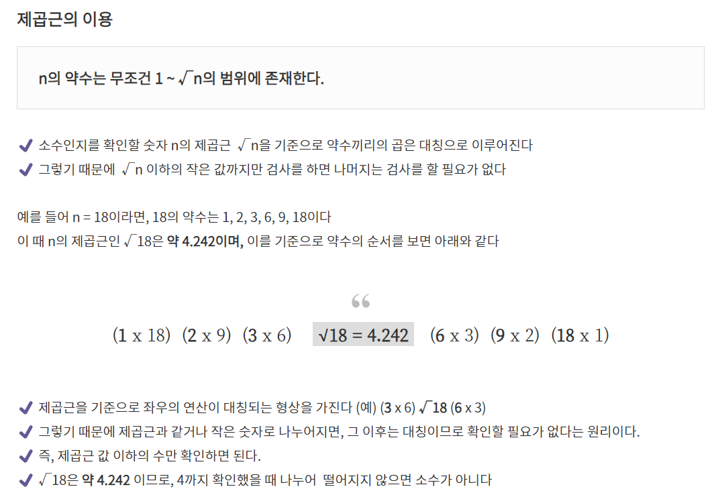
Not Brute Algorithm
https://dev-ku.tistory.com/278

Slide 143
Why Efficient?
큰 수를 작게 만들고 작은 수를 크게 만들기 위해 Log 혹은 Square root를 적용하라

Slide 144
Example: for-if
# Solution 1
import time t1 = time.time()
for n in range(2, 100000):
bPrime = True
for d in range(2, n):
if n % d == 0:
bPrime = False
break
if bPrime:
print(n, end=" ")
t2 = time.time()
print("\nTime taken:", t2 - t1, "seconds")
# Solution 2
import time t1 = time.time()
for n in range(2, 100000):
is_prime = True
if n <= 1:
is_prime = False
else:
for d in range(2, int(n ** 0.5) + 1):
if n % d == 0:
is_prime = False
break
if is_prime:
print(n, end=" ")
t2 = time.time()
print("\nTime taken:", t2 - t1, "seconds")

Slide 145
Playground
for
Item n from
range(10000, 50000)
Team competition
Make a Python program which lists all of the prime numbers from 10000 through 50000 in a shorter time.
Hint
import math
If next item
If no more item
bPrime = True
for
Item i from range(2, n)
If no more item
If next item
n % i == 0
False
True
bPrime = False
bPrime
False
True
print(n)

Slide 146
Example: for-if
# Solution 1
import time
t1 = time.time()
for n in range(10000, 50000):
bPrime = True
for d in range(2, n):
if n % d == 0:
bPrime = False
break
t2 = time.time()
print(t2 - t1)
# Solution 2
import math
import time
t1 = time.time()
for n in range(10000, 50000):
bPrime = True
for d in range(2, int(math.sqrt(n)) + 1):
if n % d == 0:
bPrime = False
break
t2 = time.time()
print(t2 - t1)

Slide 147
Nested Loops
for-for
for-while
while-for
while-while

Slide 148
Learning Objectives
for Statement
for
Control Flow in for Statement
Repetition Controls for for Statement
break Statement
for-else
for-if
for-for (nested for)
continue/break/pass Statement

Slide 149
The continue Statement
The continue statement is used to tell Python to skip the rest of the statements in the current loop block and to continue to the next iteration of the loop.

Slide 150
The continue Statement
# 주어진 리스트
numbers = [1, 2, 3, 4, 5, 6, 7, 8, 9, 10]
# 리스트에서 짝수만 출력하고자 함
for num in numbers:
if num % 2 != 0: # 홀수인 경우
continue # 다음 반복으로 넘어감
print(num, end =‘/’) # 짝수인 경우에만 출력
# 주어진 리스트
numbers = [1, 2, 3, 4, 5, 6, 7, 8, 9, 10]
sum =0
# 리스트에서 짝수만 출력하고자 함
for num in numbers:
if num % 2 != 0: # 홀수인 경우
continue # 다음 반복으로 넘어감
sum += num
print(num, end='/') # 짝수인 경우에만 출력
print(f'\nTotal sum is {sum}')
2/4/6/8/10

Slide 151
The break Statement
# 주어진 리스트
numbers = [1, 2, 3, 4, 5, 6, 7, 8, 9, 10]
sum =0
# 리스트에서 짝수만 출력하고자 함
for num in numbers:
if num % 3 == 0: # 3의 배수인 경우
break # 프로그램 Stop
sum += num
print(num, end='/') # 3의배수가 나오기 전까지 출력
print(f'\nTotal sum is {sum}')

Slide 152
The pass Statement
# 주어진 리스트
numbers = [1, 2, 3, 4, 5, 6, 7, 8, 9, 10]
for num in numbers:
# 주어진 리스트
numbers = [1, 2, 3, 4, 5, 6, 7, 8, 9, 10]
for num in numbers:
pass
for num in numbers:
^ SyntaxError: unexpected EOF while parsing

Slide 153
Example: continue
for i in range(1000000):
s = input('Enter something: ')
if s == 'quit':
break
if len(s) < 3:
print('Too small')
continue
print('Input is of sufficient length')

Slide 154
Example: continue
for i in range(1000000):
s = input('Enter something: ')
if s == 'quit':
break
if len(s) < 3:
print('Too small')
else:
print('Input is of sufficient length')

Slide 155
Example: continue
for i in range(1000000):
s = input('Enter something: ')
if s == 'quit':
break
if len(s) < 3:
print('Too small')
continue
print('Input is of sufficient length')
for i in range(1000000):
s = input('Enter something: ')
if s == 'quit':
break
if len(s) < 3:
print('Too small')
else:
print('Input is of sufficient length')

Slide 156
Example: continue
for i in range(1000000):
s = input('Enter something: ')
if s == 'quit':
break
if len(s) < 3:
print('Too small')
continue
print('Input is of sufficient length')
for i in range(1000000):
s = input('Enter something: ')
if s == 'quit':
break
if len(s) < 3:
print('Too small')
else:
print('Input is of sufficient length')

Slide 157
Example: Symmetricity
for i in range(1000000):
s = input('Enter something: ')
if s == 'quit':
break
elif len(s) < 3:
print('Too small')
else:
print('Input is of sufficient length')
for i in range(1000000):
s = input('Enter something: ')
if s == 'quit':
break
if len(s) < 3:
print('Too small')
else:
print('Input is of sufficient length')

Slide 158
Example: Symmetricity
for i in range(1000000):
s = input('Enter something: ')
if s == 'quit':
break
elif len(s) < 3:
print('Too small')
else:
print('Input is of sufficient length')
for i in range(1000000):
s = input('Enter something: ')
if s == 'quit':
break
if len(s) < 3:
print('Too small')
else:
print('Input is of sufficient length')

Slide 159
Example: continue
while True:
s = input('Enter something: ')
if s == 'quit':
break
if len(s) < 3:
print('Too small')
continue
print('Input is of sufficient length')

Slide 160
Example: continue
while True:
s = input('Enter something: ')
if s == 'quit':
break
if len(s) < 3:
print('Too small')
else:
print('Input is of sufficient length')

Slide 161
Example: continue
while True:
s = input('Enter something: ')
if s == 'quit':
break
if len(s) < 3:
print('Too small')
continue
print('Input is of sufficient length')
while True:
s = input('Enter something: ')
if s == 'quit':
break
if len(s) < 3:
print('Too small')
else:
print('Input is of sufficient length')

Slide 162
Example: continue
while True:
s = input('Enter something: ')
if s == 'quit':
break
if len(s) < 3:
print('Too small')
continue
print('Input is of sufficient length')
while True:
s = input('Enter something: ')
if s == 'quit':
break
if len(s) < 3:
print('Too small')
else:
print('Input is of sufficient length')

Slide 163
Example: Symmetricity
while True:
s = input('Enter something: ')
if s == 'quit':
break
elif len(s) < 3:
print('Too small')
else:
print('Input is of sufficient length')
while True:
s = input('Enter something: ')
if s == 'quit':
break
if len(s) < 3:
print('Too small')
else:
print('Input is of sufficient length')

Slide 164
Example: Symmetricity
while True:
s = input('Enter something: ')
if s == 'quit':
break
elif len(s) < 3:
print('Too small')
else:
print('Input is of sufficient length')
while True:
s = input('Enter something: ')
if s == 'quit':
break
if len(s) < 3:
print('Too small')
else:
print('Input is of sufficient length')

Slide 165
Summary
for Statement
for
Control Flow in for Statement
Repetition Controls for for Statement
break Statement
for-else
for-if
for-for (nested for)
continue/break/pass Statement

Slide 166
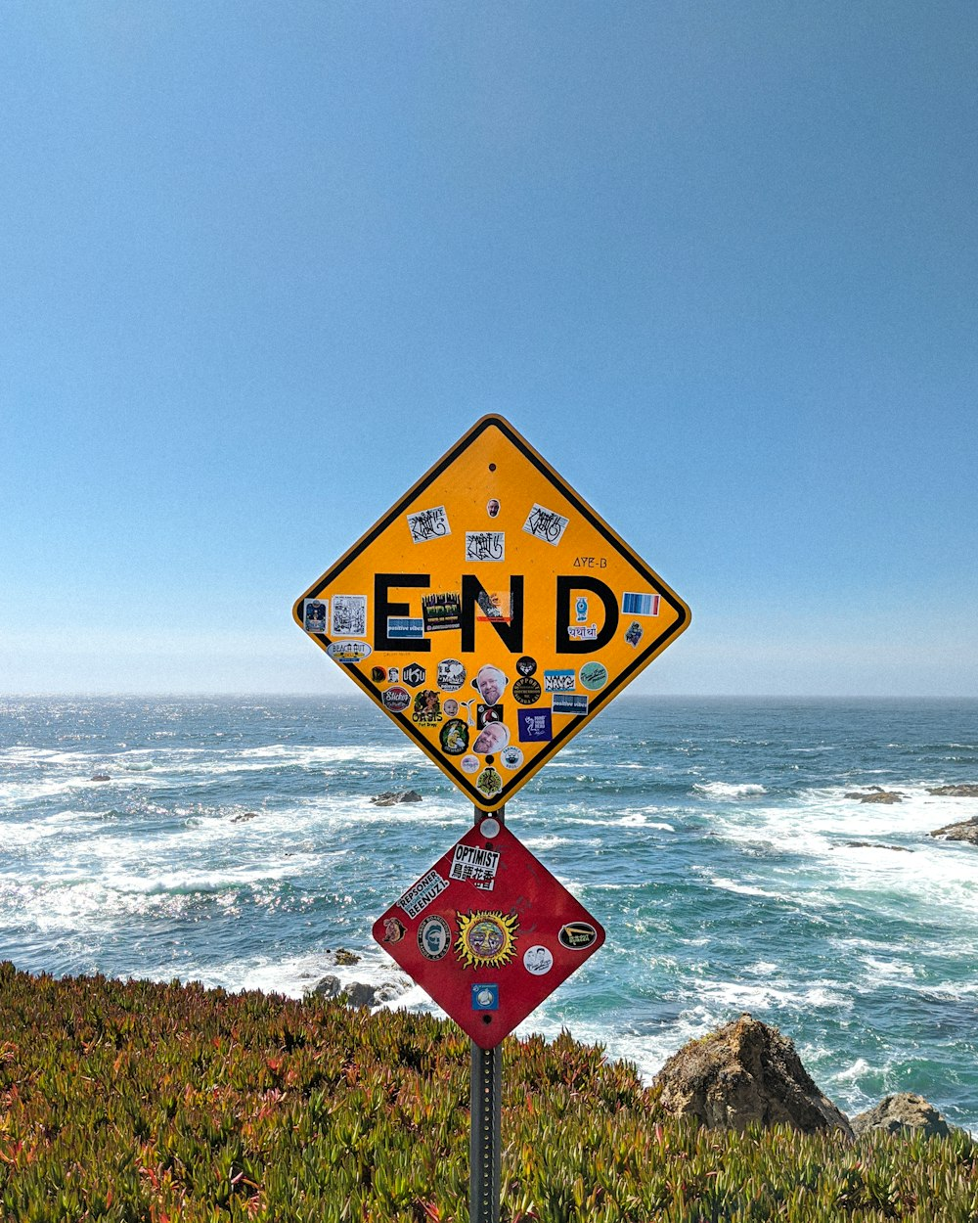
End of Python: Control Flow for Statement

